Slide 1
Using a real phone
Instead of the slow emulator

Slide 2
Using a real phone with AS
Using the phone with AS:
Install drivers if necessary (a selection of drivers are available on L: drive)
Connect phone to computer via USB
Reveal the Developer Options menu item
Enable Developer Options -> USB Debugging. Must be done for each computer.
Phone appears in run list and Android Device Monitor window. (If device is “unauthorised”, turn USB Debugging off and then on again.)
Notes:
So the emulator camera is sufficient for development, but a real phone is more fun.
You can use the phone as the device AS runs your code on. You still have access to the debugger, logcat, etc., the thing just runs on the phone instead of on the emulator.
You can also use the phone by installing your app on it and running it just as normal for any app. To do this, you have to compile your project to an installable form.
We’ll go through the first process; the second will be left as part of the practical (but if people have trouble with it, we can go through it together in class next week.)
Note that some people report problems with getting the phone to appear that can be resolved by turning USB debugging off and turning it back on again with the phone connected.

Slide 3
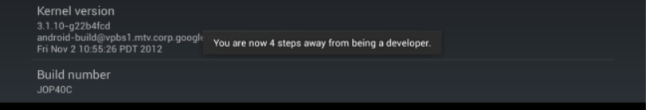

Using a real phone with AS
Reveal the Developer Options menu item
Settings->More->About Device
Scroll down to Build Number
Tap Build Number seven times (this is not a joke)
Notes:
This applies to the Galaxy S3 running 4.3.
Different versions have the Settings arranged differently, so you may have to hunt around for the Build Number..
Developer Options is now available in Settings->More

Slide 4
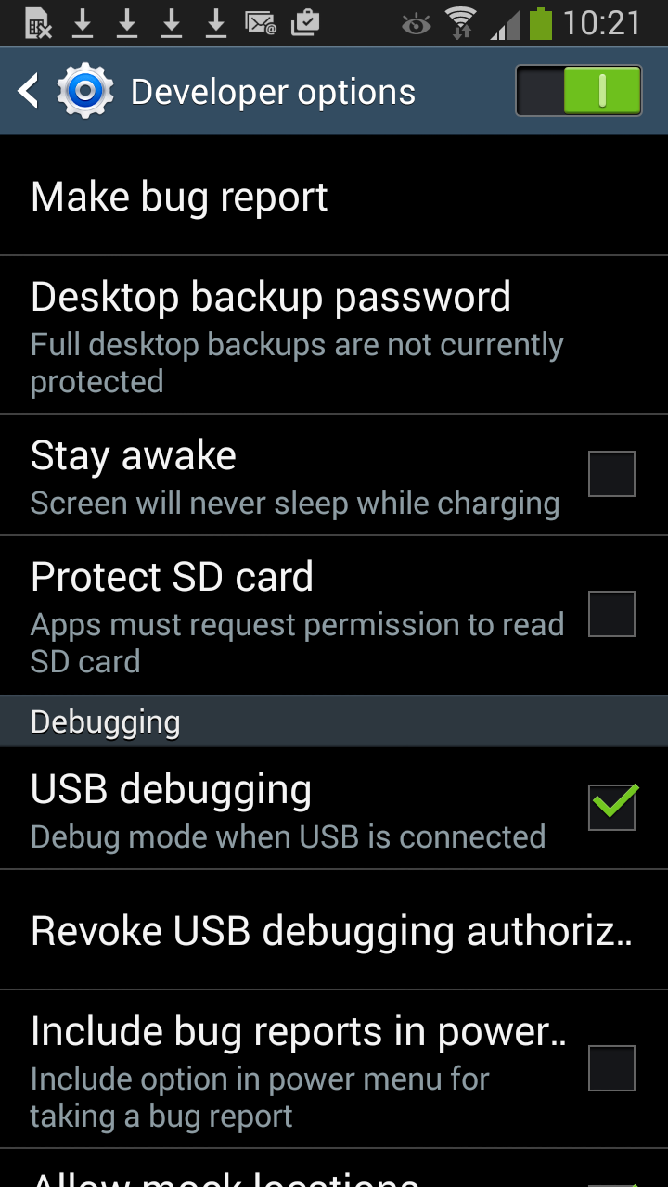
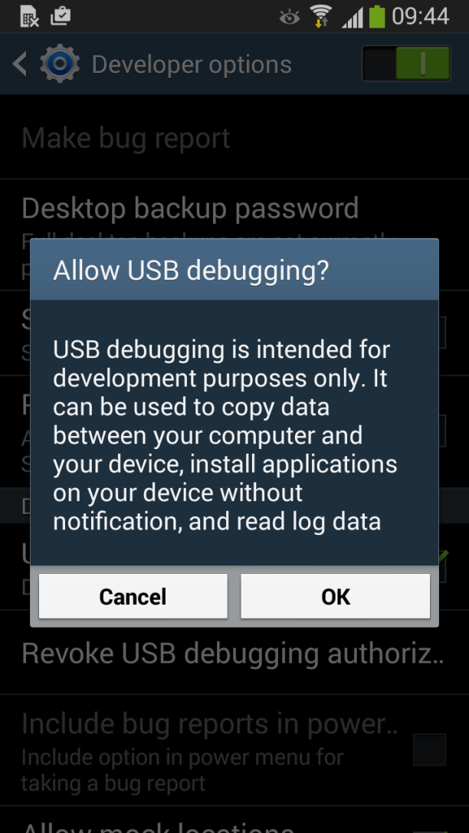
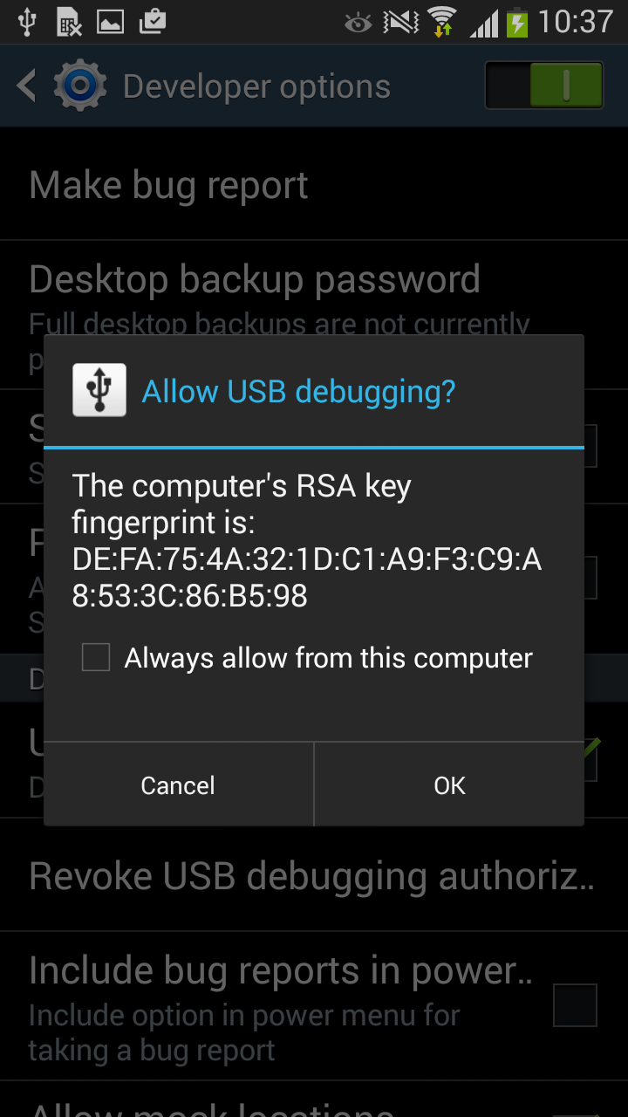
Using a real phone with AS
Notes:
Turn on USB Debugging...
Settings->More->Developer Options

Slide 5
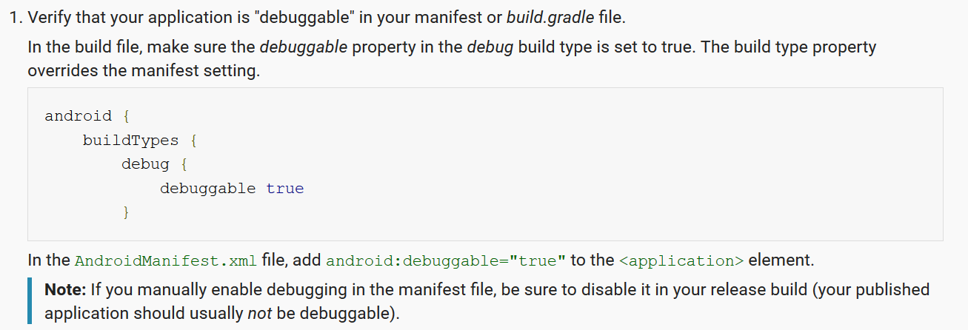
Using a real phone with AS
Technical note:
http://developer.android.com/tools/device.html
Notes:
The docs say this is required.
I’ve actually run on the phone without it, but it’s worth being aware of.
In fact, you should read this whole module to learn more about using AS with a real device.

Slide 6
Deploying to a real device
Generate a signed .apk (see docs)
Email it to the user
When the user opens the email attachment, they will be prompted to install.
After installation, the app works as normal.
developer.android.com/tools/publishing/app-signing.html
Notes:
AS is set up nicely for this.
Basically all you do is select the appropriate menu item and provide a path and password for a keystore file.
It does all the rest.
No difference between an app installed this way and one that comes from Play Store.

